Slide 1
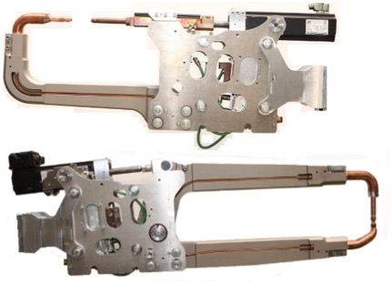
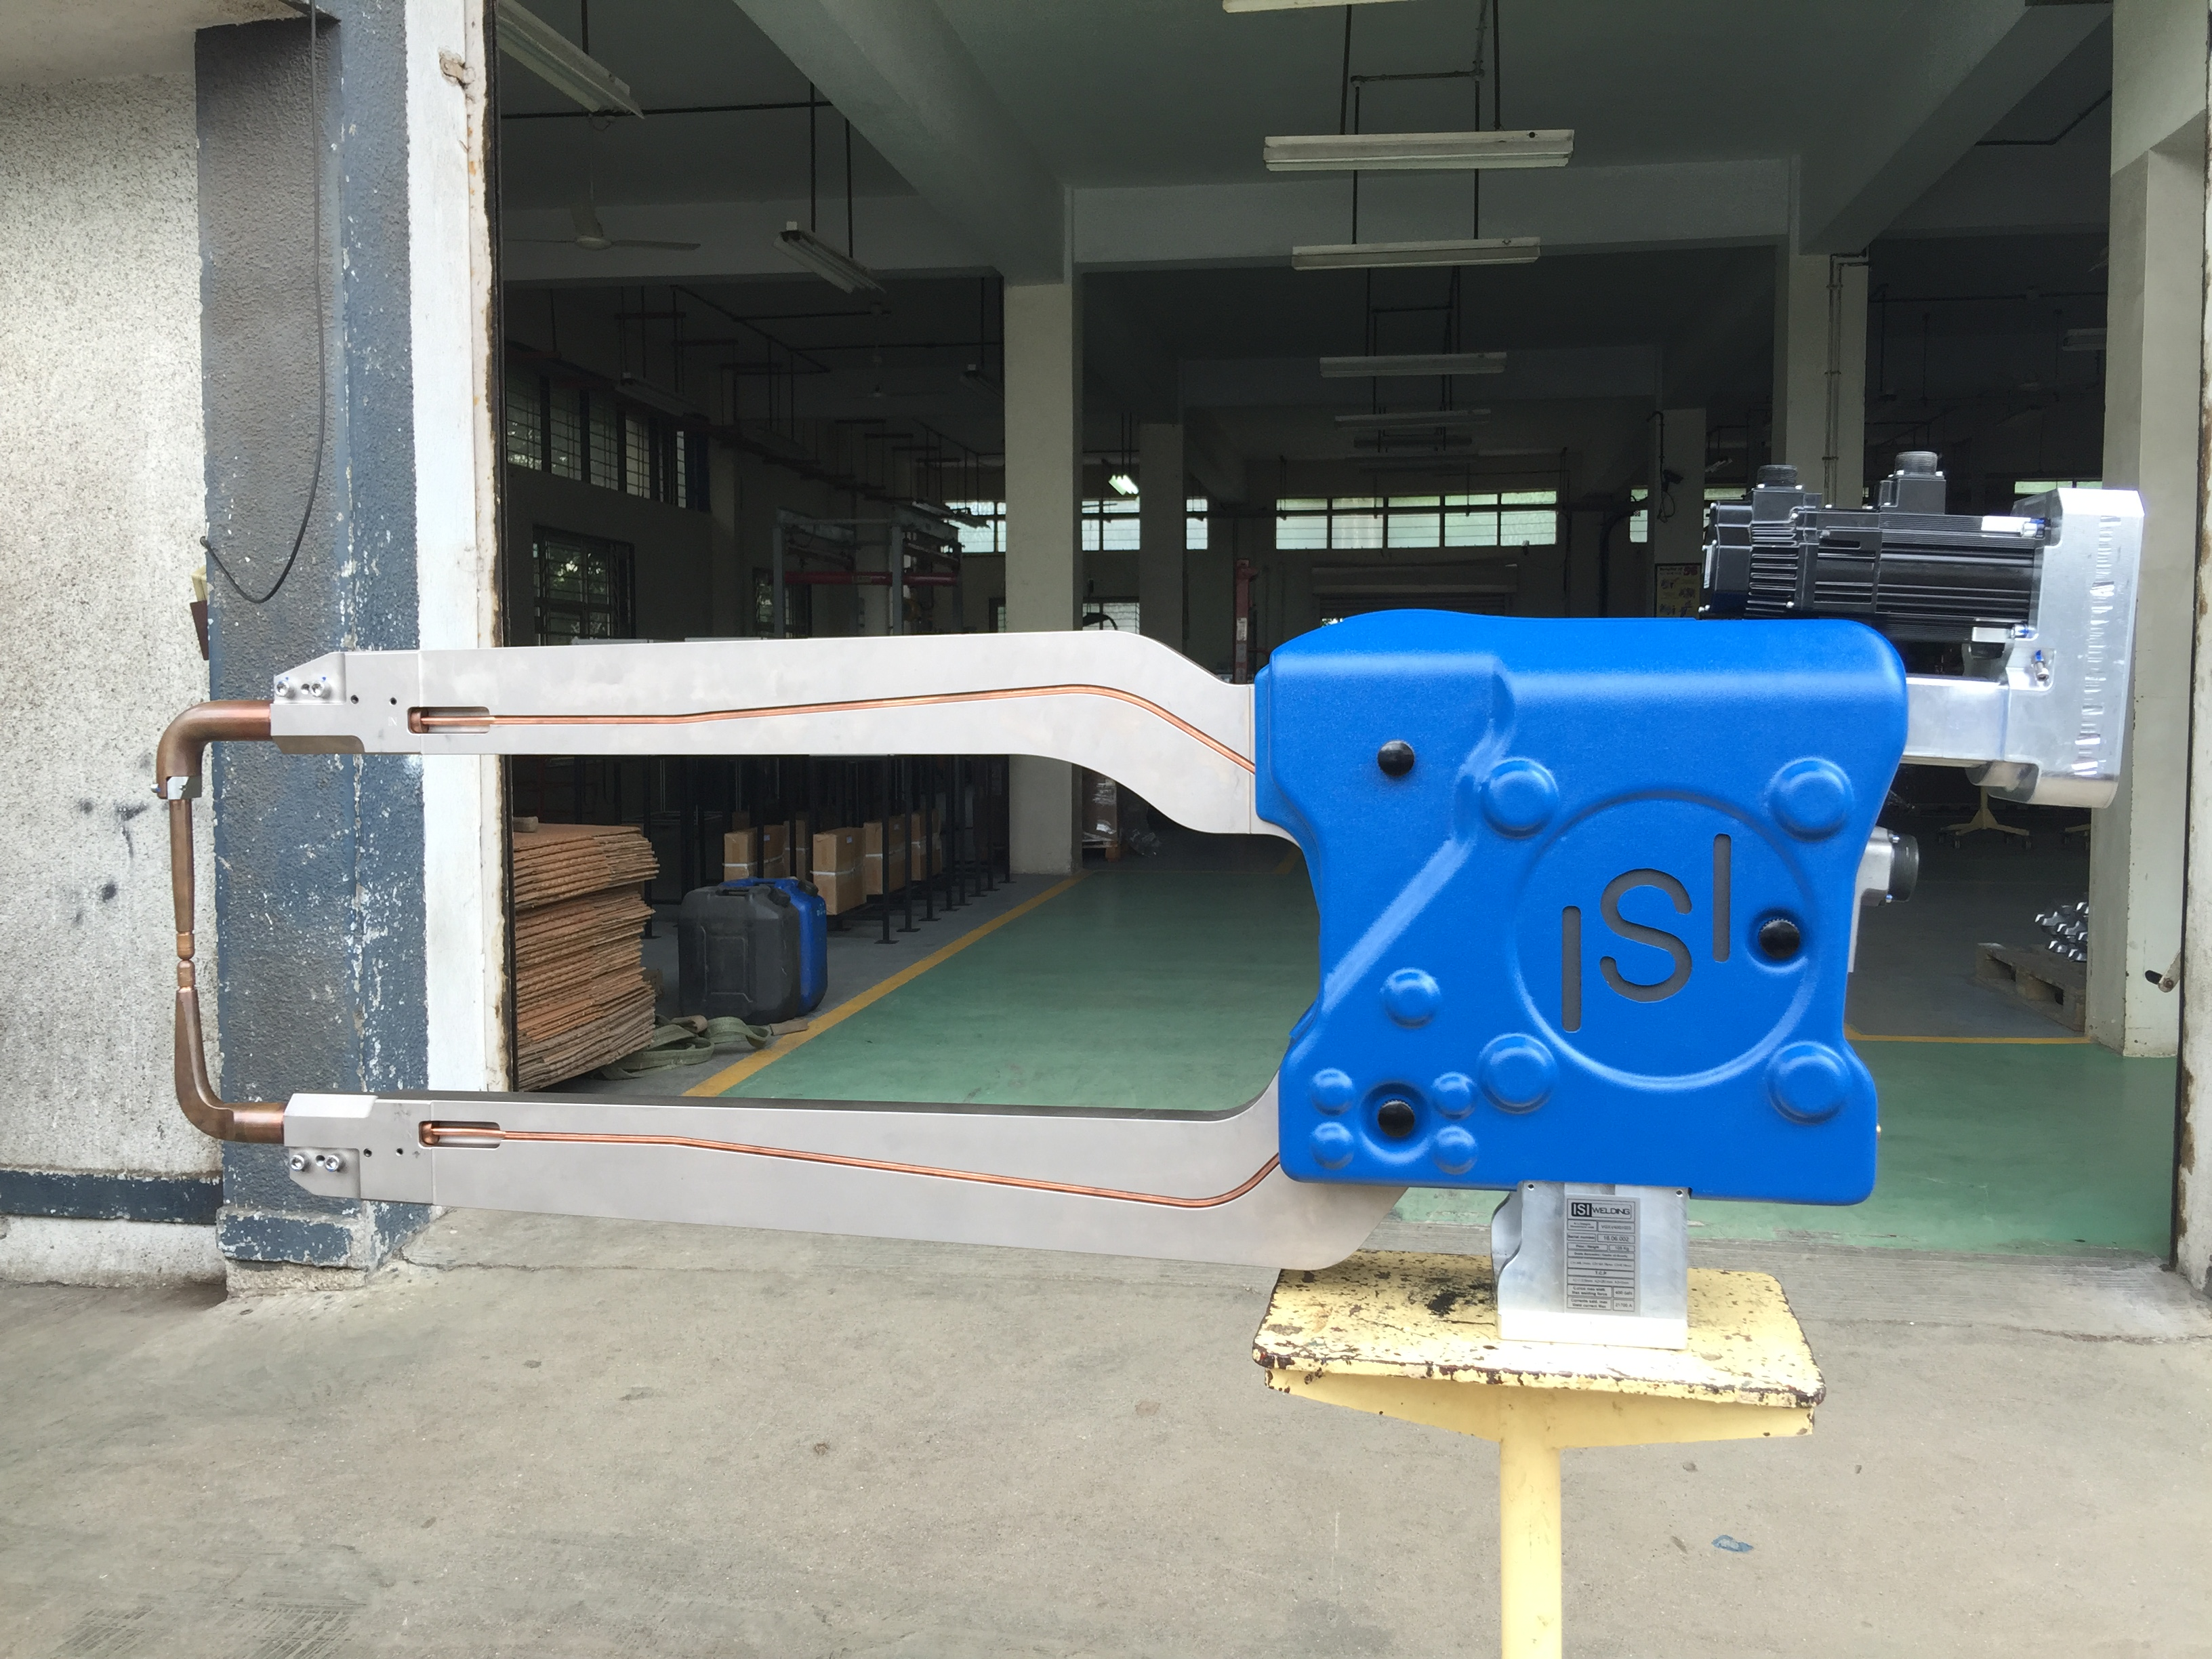
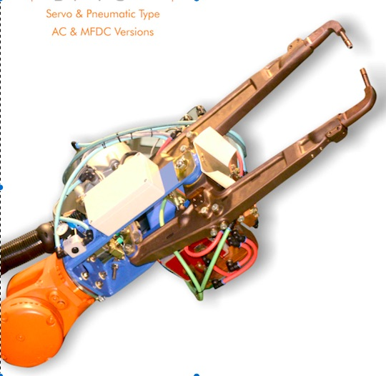
LIGHT WEIGHT SERVO ROBOTIC GUNS
NEW
AC AND MFDC VERSIONS
SERVO AND PNEUMATIC ROBOTIC WELD GUNS

